Slide 1
Project Report Presentation On Topic Entitled As “Eventiators – The Android Application To Manage Your Events”
Project By – 1 . Lokesh Patil [1806101]
2. Md Asif [1806091]
3. Mrudul Narkhede [1806097]
4. Hrushikesh Patil [1806100]
Under The Guidance Of – Prof T . P. Sharma [ Government Polytechnic Pune]

Slide 2
Contents -
Introduction
Problem Statement
Existing System
Proposed System
Project Objectives
Implementation Methodology
Working Mechanism
Results And Discussions

Slide 3
1 . Introduction
This project is aimed at event management with ease . Despite of all the traditional methods for event management by knowing the event managers for their profession the project is designed for making the customer self dependent in case of managing the happy moments with their events .
To the real life problem of society for troubling process of event management will be reduced to the next level by the android application.

Slide 4
2. Problem Statement
Develop an android application which will reduce the manual tasks of ordering the required services for managing the events and to do it with smart clicks with lesser or no trouble.

Slide 5
3 . Existing System
Manually ordering of the services
Contacting the service providers and the event management organizations.
Keep tracking of order by manual task process.
Disadvantage -
Time Consuming Process
Not ensured for the quality service
Pending orders according to the availability of services
Involves all manual procedures.

Slide 6
4. Proposed System
So we here proposing the android application called “Eventiators” to overcome the problem of manual ordering of services and allowing user to do it with some of smart android clicks.

Slide 7
5. Project Objectives
Providing the event management services to organizers on android phones.
Saving time with process and reducing the manual works.
Providing the best services to user to make their events memorable with our services.

Slide 8
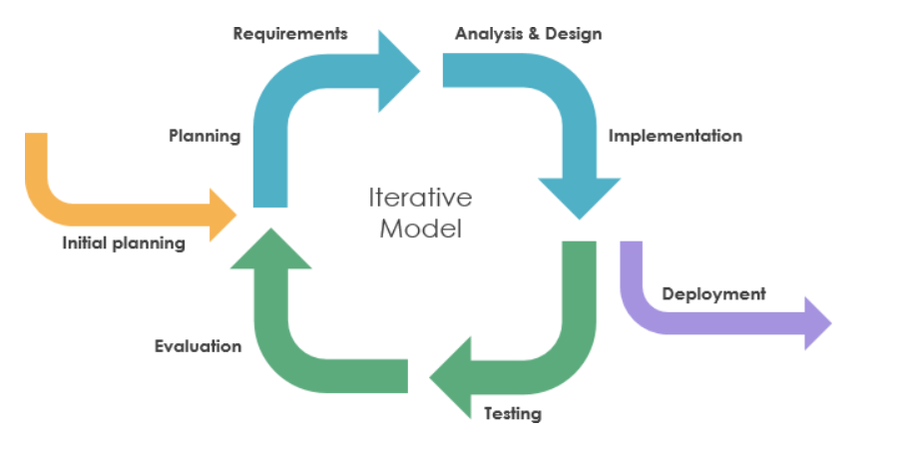
6. Implementation Methodology
At each iteration design modifications are made and new functional capabilities are added. The basic idea behind this method is to develop a system through is to develop a system through repeated cycles and in smaller portions at a time.

Slide 9
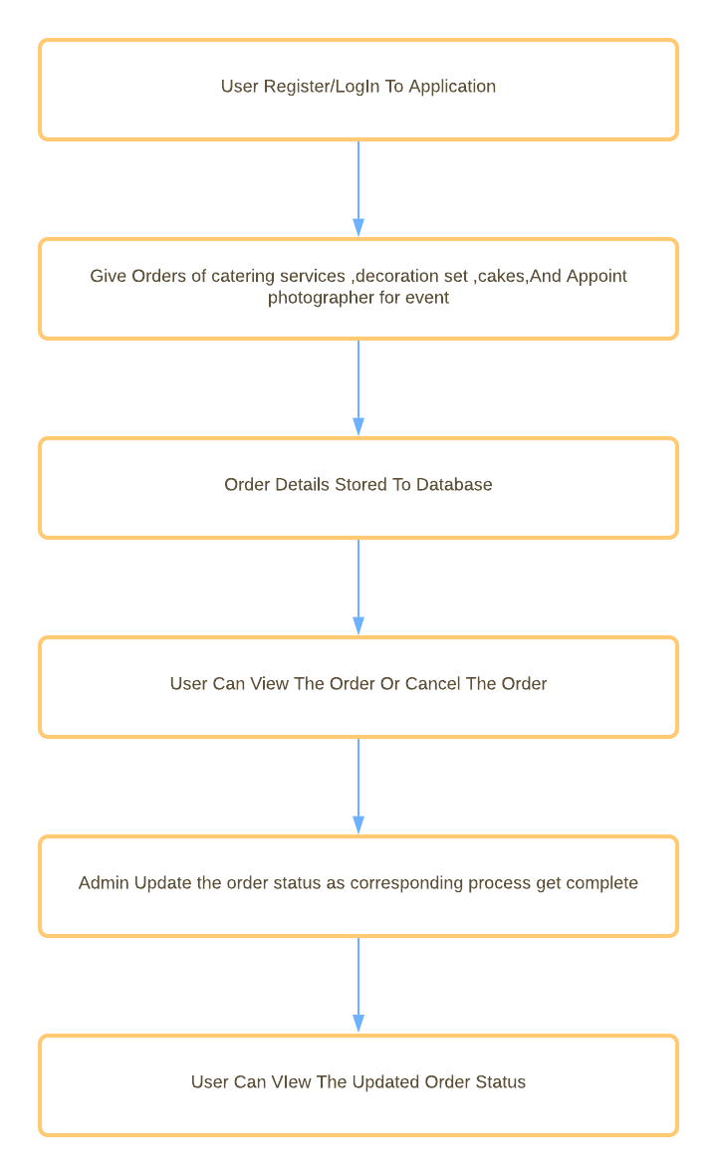
7. System’s Working Mechanism

Slide 10
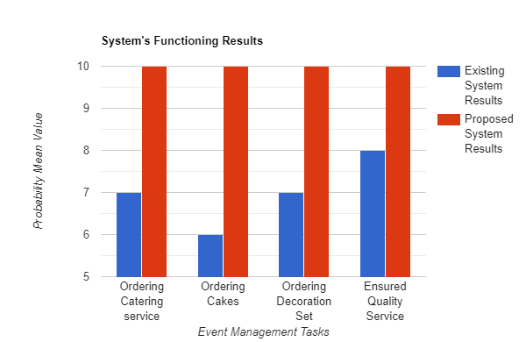
8. Results And Discussions
Discussions –
The Conclusive discussions done with the event organizers and the users to know the actual approximate requirements of the event management processes.
This discussions proved to be the proposed system is future scoped system with minimal or no error within accomplishing tasks.
Here the probability mean value is units of getting task succeed with no troubling issues or errors.

Slide 11

Let’s get into the our android application……..
Team Eventiators Welcome You All …..

